Slide 1



2023 UBS Investment Banking Development Challenge
24th May 2023
Joseph Ross, Jason Abi Chebli, Harley Wijeyaratne, Adrian Panas
For use in the 2023 UBS IB Development Challenge only

Slide 2
Executive Summary
All
Harley please try
After analysing the current environment and CapVest's proposals, UBS recommends BGH submit a revised, dual structure bid of an $8.20 Scheme and $8.15 Off-Market Takeover to secure the acquisition of Virtus
01
02
03
BGH’s Latest Offer
Current Situation
CapVest’s Latest Offer
BGH and CapVest are in a competitive bidding situation for healthcare company, Virtus Health
Virtus Health has signed a binding implementation deed with CapVest
The Virtus Board recommends shareholders vote for the CapVest Scheme unless a better proposal arises
From their first proposal which included necessary condition of CapVest’s willingness to proceed, Virtus granted CapVest exclusive due diligence
The latest CapVest Proposal was to acquire all of Virtus' shares via a scheme at A$8.25 per share and make a simultaneous off-market takeover offer of $A8.10 per share, conditional of the scheme failing and a 50.1% minimum acceptance
BGH's latest Indicative Proposal was to acquire all of Virtus' shares through a scheme at A$8.10 per share, with the condition that Virtus does not sign an implementation deed with CapVest
While BGH and Virtus were in the process of facilitating due diligence access, CapVest presented a higher bid
04
Virtus Valuation
05
Recommended Response
06
Next Steps
Using a blended average of the discounted cash flow (DCF), leveraged buyout (LBO), comparable companies and precedent transactions, an implied valuation of A$9.32 was obtained
UBS recommends that BGH submit an improved, dual structured bid of an A$8.20 Scheme and A$8.15 Off-market takeover
If Virtus' Board rejects BGH's improved bid, UBS recommends a move to block the CapVest scheme
If a situation arises where BGH can no longer bid for Virtus, UBS recommends BGH votes in favour of CapVest's scheme to maximise returns
UBS recommends that BGH proceed by:
Preparing relevant transaction documentation,
Submitting their improved offer for Virtus,
Engaging with Virtus' substantial shareholders
Prepare for a CapVest counteroffer
Source:
For use in the 2023 UBS IB Development Challenge only

Slide 3

Lead: Harley Support: Jason
Timeline – Key events
Covid Impact point
14-Dec-21: Virtus receives unsolicited, NBII from BGH
20/01/2022: CapVest initial offer and exclusive DD granted
02/02/2022: BGH appeals to Australian government takeover panel (AGTP)
23/02/2022: AGTP declares CapVest bid unnaceptable
28/02/2022: BGH updates NBII offer
01/03/2022: Capvest tables improved offer
04/03/2022: BGH submits another appeal to AGTP
10/03/2022: AGTP concludes no declaration of unacceptable circumstances – CapVest bid becomes live again
1/03/2022: Virtus enters into BID with CapVest at improved price following updated offer
I know 10 may seem like a lot, but some don't need much info – if we really need to cut some, we could combine points 4&5, 8&9 as they are linked
I also don't think we need full sentences – maybe we put the dates near the numbered dot points on the graph
Key info for each point is:
Price (scheme & arrangement)
Premium to undisturbed for first and last offers
Important clauses / reasoning – e.g. exclusive DD granted, why AGTP declared bid acceptable / unacceptable
Note we can talk to these points in more detail in the presentation, and some of these points will be explored further in our strategy / deal structure
Think of this slide as an improved version of the timeline they gave us in our info booklet, with a share price graph
Also please check sources
Situation Overview
AP - Change graph to formatted from excel; change x-axis formatting to mmm-yy; Inc font size of callouts
JR - I have sent an excel doc with graph info to the chat
Virtus’ share price is currently at an all-time high amidst the ongoing bidding war between BGH and CapVest
Share Price Performance (A$) - Last 3 years
7
8
3
5
JR - I was looking at SP history – can someone pls find out why they dropped from ~$7.40 in Aug-21 to $5 by Dec-21?
Really important for context of BGH's first bid timing and price
4
6
1
2
Commentary
1
VRT temporarily forced to cease operations as elected surgeries were suspended due to COVID-19
3
VRT entered in to a Process Deed with CapVest following their offer via; (I) scheme at A$7.60; and (ii) off-market takeover at A$7.50
5
BGH submits a revised offer (A$7.65 scheme) which is followed the next day by a revised offer from CapVest (A$7.80 scheme and A$7.70 takeover)
7
BGH submits their latest revised offer at A$8.10 per share via takeover; a 55% premium to the undisturbed closing price
2
BGH acquired 19.99% stake in VRT at A$7.10; a 36% premium to the undisturbed close. The next day they submitted a NBIO to acquire 100% of VRT shares via a scheme.
4
BGH submitted a successful appeal to the AGTP, who found that VRT's exclusivity agreement with CapVest is unacceptable
6
BGH submits another appeal to the AGTP which was unsuccessful after the AGTP concluded no unacceptable circumstances
8
VRT enters into binding implementation deed with CapVest following revised offer (A$8.25 scheme and A$8.10 takeover)
Source: Company Announcements and Barchart as of 14 March 2022.
For use in the 2023 UBS IB Development Challenge only

Slide 4
CapVest's Indicative Proposal to Acquire Virtus Health
CapVest's $8.25/share offer means Virtus shareholders will receive A$8.13/share after the A$0.12 dividend
+60%
+55%
+51%
+39%
+39%
+38%
16%
+2%
Analysis
VRT Historical Performance
With the ARS industry protected by significant regulation, capital requirements, and staff specialisation, VRT is insulated from the threat of new entrants taking market share
We do not see significant risk to VRT from any upcoming healthcare regulations
Considering BGH’s successful track record in the Healthcare Industry, a likely increase in VRT revenue could demand a higher multiple
Source:
For use in the 2023 UBS IB Development Challenge only

Slide 5
All
Rationale for the Transaction
Whilst Virtus looks to capitalise on a bidding war, CapVest and BGH offers centre around strategic outlooks
Rationale for Virtus
Rationale for CapVest
Rationale for BGH
1
Maximising Shareholder Value
1
CapVest has extensively researched the ARS sector
1
Market Timing
VRT's share price has been driven up by the bidding war, currently trading at ~c.70% premium to pre-covid prices
A failure to reach a deal would likely see a drastic fall in the share price
CapVest stated that they spent 5+ researching the ARS industry to gain a nuanced understanding of the market dynamics and growth drivers, and have thus recognised that VRT is the best acquisition target in
When BGH made their initial offer VRT was trading at a c.40% discount to their 2021 peak levels, despite their long term operational and intrinsic value not changing
2
Macroeconomic Uncertainty
2
Virtus Health is the market leader in Aus
2
Integration Potential
With ongoing uncertainty regarding the Delta Variant/Ukraine conflict, the tabled offer provides asymmetric upside by eliminating downside risk and providing an attractive premium
The opportunity to acquire the leading Australian player in an industry that is set to benefit from favourable demographics and has significant barriers to entry.
BGH has a demonstrated history of success in the healthcare industry and there is an opportunity to integrate VRT Health with Healius Primary Care to increase their presence and create a holistic ARS offering
3
Facilitate Overseas Expansion
3
BGH's offer has drawn out a bid
3
Expansion into New Markets
In the case that BGH/CapVest acquire a non-controlling stake in VRT, shareholders will benefit from the international scale, operational expertise, and network effects of the two bidders
It is likely that CapVest had been assessing a potential acquisition of VRT for a significant period of time, before the BGH bid forced their hand.
BGH sees the opportunity to grow VRTs’ market share through expansion into new segments and countries, in the absence of inorganic growth opportunities in Australia due to competition concerns.
Source: Company Filings.
For use in the 2023 UBS IB Development Challenge only

Slide 6














Assessing the offers - Value
Could put icons on the left for each element
All
BGH and CapVest's offer similar share prices, but include distinct structures and additional value features
Element | BGH - 10th Mar 22 | CapVest - 14th Mar 22 | Commentary
Structure | Scheme of arrangement | Simultaneous / dual structure – Scheme of arrangement and Off-market takeover | BGH’s appeals to AGTP and VRT’s public announcement have tainted friendly nature BGH may need to introduce dual structure
Price | A$8.10 per share | A$8.25 cash for scheme A$8.10 cash for off-market takeover | CapVest’s scheme more attractive BGH’s to use 19.9% stake to block scheme If successful, value is equal
Premium to undisturbed (A$5.21) | Scheme represents a 55.5% premium | Scheme represents a 58.3% premium Off-market represents a 55.5% premium | As above
Additional Value Features | Major fertility specialist shareholders may wish to continue exposure to VRT BGH has proposed cash and scrip alternative to these shareholders | A fully franked special dividend providing up to A$0.44/share Shareholders could release up to A$0.19/share in franking credits attached Amount payable by CapVest under Scheme or Takeover Offer will be reduced by amount of special dividend | BGH’s scrip option is unique, but introduces added complications Tax benefits generated from special dividend and franking credits may allow shareholders to realise more value than a BGH offer at same purchase price
Source: ASX Announcements
For use in the 2023 UBS IB Development Challenge only

Slide 7
Assessing the offers – Key Terms
Could put icons on the left for each element
All
Primary non-value factors that Virtus' Board are concerned with are funding, DD, commitments & clauses
Element | BGH - 10th Mar 22 | CapVest - 14th Mar 22 | Commentary
Funding | Received highly confident debt financing letters from a number of institutions to support BID | Fully funded (through CapVest Fund V) | CapVest funding is more secure, but was not at the time of BGH’s recent bid BGH’s next offer must be fully funded
Due Diligence | Limited due to CapVest’s previous exclusivity | Substantial level undertaken | BGH has had significantly less time to conduct DD, but is unlikely to be granted additional time to catch up Introduces risk for BGH
Commitment | Non-binding Indicative Offer (NBIO) | Binding Implementation Deed (BID) + Transaction Implementation Deed (TID) | BGH must increase commitment of next bid as it a key consideration by VRT
Provisions & Clauses | Incorporated provisions from previous CapVest PD, plus: ⁽¹⁾ No competing discussions No DD (subject to FID) Equal access to non-public information Notification obligation VRT can't enter agreement with CapVest for 20 business days | Similar key provisions and clauses between the parties, bar additional BGH clauses (All clauses exclude CapVest unless stated) | CapVest likely to add BGH clauses regarding dual exclusivity as mutually beneficial and prevents interlopers BGH’s request to block VRT entering agreements with CapVest for 20 business days is highly unlikely to be approved now as CapVest’s offer has a faster timeline
Source: ASX Announcements
Note (1): All clauses exclude CapVest unless stated
For use in the 2023 UBS IB Development Challenge only

Slide 8
Could put icons on the left for each element
Joseph
Considerations for BGH’s Improved Offer
BGH's next offer must show material improvements to more than value alone as other key considerations outlined by the VRT Board currently favour CapVest’s outstanding offer
Element | Recommendation | Rationale | Risks
Timing | Provide VRT with an updated offer no later than 18th May | VRT's board has made timeline a key consideration | BGH's Investment Committee may not have time to finalise the offer
Structure | Include dual structure, simultaneous Scheme and Off-market takeover | Schemes most effective when friendly Friction generated by BGH’s appeals to AGTP and potential perception that BGH is restricting VRT shareholders from realising maximum value Off-market creates another path to acquiring VRT | BGH has not included an Off-market option to date so including it now may signal they don’t think they can get a scheme approved Adds additional complexity to the situation
Value | BGH should offer: A$8.20 for a Scheme, and A$8.15 for an Off-Market takeover | BGH's blocking stake means CapVest's Scheme is unlikely to succeed, so shareholders will focus on A$8.10 Off-Market offer price BGH is more likely to get a Scheme approved If their scheme fails, Off-market comes into effect and VRT shareholders will still realise more value than from CapVest's proposal | Risk of overpaying is heightened due to high premium to undisturbed, offer price increases driven by competitive tension Limited access to DD means BGH is not clear on all aspects of acquisition and VRT operations
Funding | Fully funded offer | BGH must match CapVest with a fully funded offer | BGH may have to accept less favourable debt terms to secure facilities in a short time frame This
Due Diligence | Offer despite limited DD conducted Ask for access as part of next stage Add in a break clause if BGH finds significant, materials issues in VDR | VRT is not going to grant BGH further access to DD without receiving a significantly better offer Adding a clause can protect BGH and is unlikely to be used given CapVest flagged no issues with DD | VRT may not accept the DD clause Significant, material findings made by BGH in the VDR could lead to costly break fees or forced transaction
Commitment | BID and TID | BGH must increase commitment of next bid as it a key consideration by VRT | Submitting a BID and TID lock in above risks
Source: Company Filings.
For use in the 2023 UBS IB Development Challenge only

Slide 9
Indicative Valuation Analysis
Assessing Virtus through several valuation methodologies has led to an implied value of A$9.32 per share, driven by the multiples transacted in relevant Precedent Transactions
CapVest Bid
Implied Value
Weighting in Blended Valuation
10%
Market Valuation
20%
Capacity to Pay
30%
Fundamental Valuation
40%
Market Valuation
0%
For use in the 2023 UBS IB Development Challenge only

Slide 10
Might not be a whole slide
Lead: Jason
Support: Harley
If you wanted a chart, could use something like this or this
COVID-19 Impact on Operations
Gone through and created a new slide (next slide) on just covid-19 impact. Delete this one if youre happy with the new one. - Jason
JR - What should we call this section? Because its not just about COVID-19. I also talk about due diligence and concerns relating to both. I am unsure about whether we should commit a whole slide to COVID-19, I think doing half is better and then talking about due diligence. I don’t think we should focus more on covid. I think due diligence is important to discuss.
Maybe we can call it, ‘COVID-19 and Due Diligence Concerns’ or something like that.
~ Jason
Virtus Health faces uncertainty with non-essential classification and lockdowns, while favouring CapVest's proposal over BGH's.
COVID-19 Short and Medium Term Impact In FY20, fresh cycles in Australia fell by 4.4% and revenue dropped by 7.5% while competitor Monash IVF revenue only dropped by 4.3%. Government support programs provided $7.7m to support Virtus Health's operations. In FY21, Virtus Health experienced significant growth, with fresh cycles increasing by 26.4% and revenue bouncing back by 25.3%. Virtus Health clinics have returned to normal trading activity, surpassing previous year's patient activity, and the company is now recognised as one of the top five global providers of Assisted Reproductive Services. | Exclusive Due Diligence to CapVest On 20 January, CapVest submitted a NBIO for a $7.60 scheme and $7.50 takeover. In order to receive this proposal, Virtus signed a process deed with CapVest and granted them exclusive due diligence access. On 1 March, CapVest submitted a revised NBIO and Virtus noted that CapVest is expected to be in a position to enter into an implementation deed by 11 March 2022. On 10 March, BGH tabled their latest proposal and Virtus was engaging with BGH in relation to the basis on which it would facilitate due diligence access for BGH. However, was not granted as CapVest tabled an improved binding proposal, which they accepted.
Concerns/Issues Due to being classified as non-essential in all operating countries except Singapore, and the persistent lockdowns throughout 2021, uncertainty looms over future operations. There are concerns about potential impacts from future strains of the virus or other future economic crises, as well as uncertainties regarding the possibility of future bailouts. Virtus Health’s board appears to show a greater interest in pursuing a transaction with CapVest - having granted them a limited period of due diligence from their first offer as well as receiving an “overwhelming” support from their fertility specialists (as reported by Virtus Executive Director). | Concerns/Issues
JR – good work on the graphs Jason – some feedback:
Where have the numbers come from for cycles LTM? Looks way too low – also what is the graph trying to say? Cycles seem to have gone up during covid and so did rev – graph actually implies covid was beneficial
Go over the info in our info booklet – I don't actually think COVID had a significant impact on VRT and I thik they are positioned to be very resilient compared to other industries if global pandemics happen due to healthcare being deemed an essential service
Could potential make a timeline (can use arrows or bubbles with dates), or a graph similar to SP graph but with dates for when government regulations hindered their operations, then when they were eased/lifted
An idea for how to layout slide (if we do a whole slide) - quadrants
Initial government response and effect on operations
Numercial evidence on effect of operations until restrictions were lifted
Medium term outlook from a regulatory / revenue perspective
Commentary on how significant we see the risks are
Alternative layout (2 boxes – can be vertical or horizontal)
Box 1 – short term effect (similar info to other layout)
Box 2 – medium term effects
Timeline of announcements against share price
Alternative layout
2 info boxes (short term, medium term)
Graph with effect on revenue FY19vFY20vFY21 to show drop & rebound
Please lmk your thoughts Jason
Source: Company Filings, including ASX Announcement on 14 March 2022.
For use in the 2023 UBS IB Development Challenge only

Slide 11
Joseph/Adrian/Harley
Indicative Valuation Analysis
Football Field
Assessing Virtus through several valuation methodologies has led to an implied value of >A$xx.xx per share which UBS would advise as the minimum/maximum/appropriate acceptable bid subject to changing conditions
12-month
Football Field
Key Assumptions
Market References
Broker price?
FY22E Forward EBITDA
Relative Valuation
FY21 EBITDA
Bear
DCF
Base
Bull
LBO
Source:
CapVest Bid
Implied Value
For use in the 2023 UBS IB Development Challenge only

Slide 12
Harley
Potential Value Uplift Drivers
Multiple opportunities for BGH to extract value from acquiring Virtus
 | Integration with Healius Primary Care | Expansion into New Segments and Markets | Strategic Acquisitions
Description | Opportunity to integrate Virtus with Healius, which has 69 medical centers across Australia | Opportunity to target the male ARS segment and whilst aslo expansion into such as WA/SA as well as Asian markets. | Opportunity to acquire a smaller player in the ARS market to increase Virtus' market share.
Advantages | Increase scale and presence in the Australian market to increase market share. Establish a holistic offering for women's health by providing complementary services such as female GP's and female urology. | Tap into the burgeoning Asian market and reduce reliance on the Australian sector Access new sources of growth to diversify revenue streams | Opportunity to immediately gain market share and
Considerations | Significant costs involved with integration of two companies Highly dependent on ability to execute | Large investment required for expansion not typically associated with financial sponsor strategies | Regulatory concerns surrounding competition may limit the potential for acquisitions
Source: Company Filings.
For use in the 2023 UBS IB Development Challenge only

Slide 13
Harley
Key Risks
Virtus Health faces multiple internal and external risks, most notably; compliance risk, government funding risks and personnel risks
Too much content – cut down
Change bubble matrix to square risk matrix or other format
Bubble Matrix
Investment Risks | Investment Risks | Mitigations
 | Compliance Risks: ARS companies face stringent regulations, compliance requirements, and the need for substantial R&D investment due to technological advancements | Implement a comprehensive compliance program, conduct regular internal audits, and seek guidance from legal and compliance experts to mitigate compliance risks faced by your ARS company
 | Government Funding Risks: ARS is currently is being funded through a combination of government reimbursement schemes and out-of-pocket. If the government decides to change their focus on providing medical funding, patient demand would decrease | Diversify revenue streams, invest in R&D to help create lower future costs and proactively engage in advocacy efforts to influence and maintain government support for medical funding
 | Potential Competition: The ARS industry will likely see increased competition that may reduce Virtus' market share. The ACCC competition concerns regarding the Adora Fertility acquisition further indicate challenges for Virtus to achieve growth | Focus on enhancing its competitive advantages, innovating its services, building strong customer relationships, and pursuing strategic partnerships or acquisitions to strengthen its market position and drive growth
 | Future Crisis: During the COVID-19 pandemic, Virtus Health shutdown for a period in all countries except Singapore due to being considered non-urgent surgery. Similar future shocks could impact the business | Implement robust contingency plans, diversify service offerings, maintain cash reserves, and closely monitor regulations
 | Personnel Risks: During an acquisition, particularly in the case of a hostile takeover, the resignation of key management personnel may pose risks to Virtus Health's future and organizational culture | Implementing competitive stock and remuneration plans can help mitigate personnel risks during an acquisition, ensuring alignment, retention, and motivation of key management personnel
1
1
High
2
2
Significance
3
Medium
4
3
5
Low
4
Low
Medium
High
Probability
5
- External Risk
- Internal Risk
Source: Company Filings.
For use in the 2023 UBS IB Development Challenge only

Slide 14
COVID-19 Impact on Operations
Despite facing temporary setbacks due to the impact of COVID-19, Virtus Health has demonstrated remarkable resilience and has now successfully rebounded, reaching unprecedented financial milestones
Short-Term Impact – FY20 Being classified as ‘non-urgent’ surgery, operations temporarily ceased in all operating countries except Singapore and patient demand was negatively impacted with job security, income stability and health risk concerns. Virtus health revenue dropped by 7.5% with estimated loss of gross profit as a result of restrictions amounted to approximately $14.6m. Government support programs provided $7.7m to support Virtus Health's operations. Board deferred March dividend payment to the next financial year as well as did not pay a final dividend due to liquidity concerns. | Virtus Health Performance
Medium-Term Impact – FY21 Achieved COVID-19 Controls KPI, with no Virtus facilities requiring to close. Virtus Health clinics returned to normal trading activity, surpassing previous year's patient activity, and the company is now recognised as one of the top five global providers of Assisted Reproductive Services. Overall, Virtus experienced significant growth, with revenue bouncing back by 25.3%, despite new fears of future strains.
Source: Company Filings, including ASX Announcement on 14 March 2022.
For use in the 2023 UBS IB Development Challenge only

Slide 15
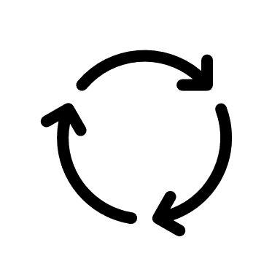
Lead: Joseph
Support: All
Recommendation and Next Steps
UBS recommends BGH submit a dual structure, A$8.20 Scheme and A$8.15 Off-Market Takeover for Virtus, followed by contacting other key shareholders to convince them of the offers superior value
1
Prepare Documentation For Updated Bid
2
Submit Updated Bid to Virtus by End of Week
3
Contact Other Key Shareholders About Upcoming Votes
4
Prepare For a CapVest Counteroffer
Contact Other Key Shareholders About Upcoming Votes
Prepare Action Plan for a CapVest Counteroffer
Convince other shareholders that BGH’s offer provides more value by outlining the potential tax implications associated with a return of capital
Gauge shareholder support regarding their preferred acquisition method (Scheme Vs Off-Market) to determine the likelihood of success of the CapVest scheme
Analyse CapVest’s best response to our offer, and if they have the capacity to submit an improved offer.
Identify and prepare for likely clauses that CapVest might introduce to improve their deal
Begin analysis on future bid strategy in the case CapVest submits a counteroffer
Source:
For use in the 2023 UBS IB Development Challenge only

Slide 16
Appendix
Main Slides
Company and Industry Overview
Potential Issues
Supplementary Valuation Analysis
For use in the 2023 UBS IB Development Challenge only

Slide 17
All
Appendix Slides
IV. Appendix – Supplementary Valuation Analysis
II. Appendix -Company and Industry Overview
III. Appendix – Potential Issues
I. Main Slides
Slide 1
Slide 1
Slide 1
Slide 1
For use in the 2023 UBS IB Development Challenge only

Slide 18
Assessing the offers – Key Other Factors
Approvals Required and Virtus' Current Response to CapVest's Offer Must Be Factored Into BGH's Next Bid
Element | BGH - 10th Mar 22 | CapVest - 14th Mar 22 | Commentary
Other Approvals | Applied for NON from FIRB, expects to receive soon Recent appeal to AGTP on 4th May was unsuccessful Wanted auction process Unhappy with head start given to CapVest on DD Requested standstill until 20 business days after VRT grants access to entire VDR Final approved required from BGH’s Investment Commitee | Applied for NON from FIRB | BGH’s FIRB application is further progressed, unlikely to swing deal AGTP appeal rejection puts significant pressure on BGH, particularly the DD disadvantage being cemented No longer an option to stall / change CapVest’s deal structure & terms Appealing to AGTP can be seen as invalidating decisions made by VRT board, may decrease chance of friendly scheme BGH’s Investment Committee needs to confirm soonest meeting date
Current Virtus Response | VRT resolved to engage with BGH to determine whether NBIO could become binding After receiving CapVest’s offer and signing TID, VRT board has decided not engage further or provide DD access to BGH | VRT Board unanimously recommended the Binding CapVest Transaction in the absence of a Superior Proposal and subject | VRT is still willing to engage with BGH, but must receive a superior offer VRT announced superior offer(s) will need to show improvements to: funding, binding, reduced conditions, expedited timeframe BGH is now in a vulnerable position as they must play catch up to CapVest and tabling a new bid comes with risks around DD
Source: ASX Announcements
For use in the 2023 UBS IB Development Challenge only

Slide 19
Shareholder Register
Jason
There is Significant Uncertainty that the CapVest Scheme Will Meet the Required Approval Thresholds.
Shareholder Register – Substantial Shareholders
Commentary
Holder | Shares Held (m) | Shares Held (%)
BGH Capital | 17.1 | 19.99%
Paradise Investment Management | 8.4 | 9.76%
Yarra Capital Management | 5.4 | 6.37%
Mitsubishi UFJ Financial | 4.3 | 5.01%
Dimensional Fund Advisors | 4.3 | 5.00%
Total – Substantial Shareholders | 39.5 | 46.13%
Under a scheme of arrangement, any offer will require more than 50% of Virtus shareholders present and voting and at least 75% of votes to be cast in favour of the offer for it to be approved
BGH holds 19.99% of shares, and will be voting against the scheme. Just 5.01% of remaining shares are required to achieve the 25% needed to block the scheme.
Given BGH’s 19.99% stake and recognising that voter turnout at scheme meetings is often substantially lower than 100%, there is significant uncertainty that the CapVest Scheme will meet the required approval thresholds. It is worth noting that at Virtus' most recent Annual General Meeting held on 18 November 2021, an average of less than 60% of votes were cast on each resolution.
UBS advices the Board devise an action plan to work with substantial shareholders to vote against the scheme.
Source: Company Filings.
For use in the 2023 UBS IB Development Challenge only

Slide 20





Potential Interlopers
Although the Likelihood is Low, Other Potential Acquirers of Virtus Health are Listed Below
Financial Sponsor | AUM | Rationale | Potential
 | AUD$10bn | Have an interest in healthcare companies, with their Fund VI consisting of two healthcare companies, Health e Care (acquired Sept 21 for ~$300m) and citadel health (acquired Dec 20 for $503m) Acquired Evolution Healthcare for ~$300m in March 2019 (exited in 2021 for ~$750m) and LifeHealthcare for $211m in May 2018 (exited in Dec 2021 for $1.17bn)
 | AUD$3,6bn | Acquired Virtus Health in 2008 for undisclosed amount and exited in 2013 with an $339m IPO. Have an interest in healthcare companies, with their Fund no.4 consisting of ICON Cancer Care (acquired major stake in May 2014) and Enrich Health Group (acquired in June 2016) and have owned other healthcare companies such as Estia Health (acquired in Dec 2010 for $750m and exited in 2016.
 | USD$800bn | Acquired Healthscope for $4.4bn in 2019, outbidding BGH Capital in a buyout proposal for the business
Strategic Buyers | Mkt Cap | Rationale | Potential
 | AUD$16.1bn | Paired with Healius to acquire Agilex Biolabs, for $301.3 million in 2021. Virtus Health attempted to purchase Adora Fertility from Healius but stopped due to competition concerns by ACCC.
 | AUD$14bn | COO of Ramsay became CEO of Virtus Health in 2020. They have acquired 15 companies in the past, acquiring Elysium recently.
Source: Company Filings.
For use in the 2023 UBS IB Development Challenge only

Slide 21
Joseph / Adrian
DCF Valuation of Virtus
DCF Analysis Suggests Virtus has an Implied Equity Value of $8.86 Per Share on Base Case Assumptions
Free Cash Flow Build Up
Implied Share Price (A$)
Valuation Summary
 | TWACC
$ 8.12 | 6.41% | 7.41% | 8.41% | 9.41% | 10.41%
3.00% | 10.31 | 9.43 | 8.64 | 7.91 | 7.25
2.75% | 9.99 | 9.14 | 8.37 | 7.67 | 7.03
2.50% | 9.69 | 8.86 | 8.12 | 7.44 | 6.82
2.25% | 9.41 | 8.61 | 7.89 | 7.23 | 6.63
2.00% | 9.15 | 8.37 | 7.67 | 7.03 | 6.45
 | TWACC
$ 9.61 | 6.41% | 7.41% | 8.41% | 9.41% | 10.41%
10.1x | 13.68 | 12.50 | 11.43 | 10.46 | 9.58
9.1x | 12.58 | 11.50 | 10.52 | 9.63 | 8.82
8.1x | 11.48 | 10.50 | 9.61 | 8.80 | 8.06
7.1x | 10.38 | 9.50 | 8.69 | 7.96 | 7.30
6.1x | 9.28 | 8.49 | 7.78 | 7.13 | 6.54
$m | Perpetuity Method | EBITDA Multiple Method
PV of UFCF | 272.2 | 272.2
PV of Terminal Value | 511.7 | 641.7
Enterprise Value | 783.9 | 913.9
Less: Net Debt / (Cash) | 75.9 | 75.9
Equity Value | 708.0 | 838.0
Shares Outstanding | 87.2 | 87.2
Implied Value per Share | 8.12 | 9.61
Terminal Growth Rate
EBITDA Exit Multiple
For use in the 2023 UBS IB Development Challenge only

Slide 22
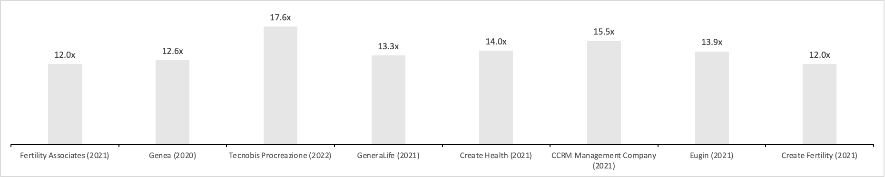
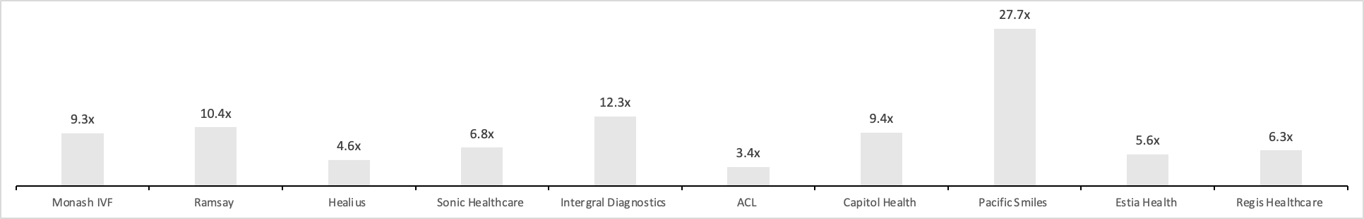
Trading and Transaction Multiples
Summarised Below are Precedent Transaction Multiples and a FY21 Forward EBITDA Multiple Summary for Comparable Companies
Precedent Transaction - EV/EBITDA Multiple
Median – 13.6
FY22 Forward EV/EBITDA Multiple
Median – 8.1
Source: Company Filings.
For use in the 2023 UBS IB Development Challenge only

Slide 23
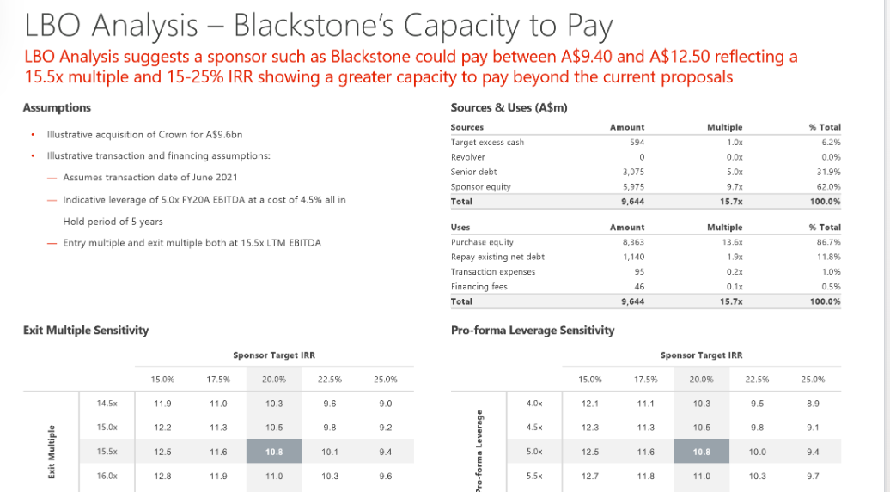
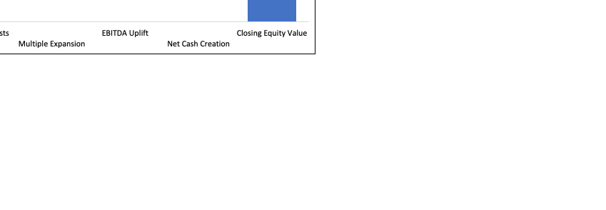
LBO Analysis – BGH's Capacity to Pay
LBO analysis suggests a PE fund such as BGH could pay between A$8.08 and A$9.83 reflecting 16.2-26.3% IRR showing a greater capacity to pay beyond the current proposals
Adrian​
interest rate assumption - rf rate at mar-22 + 600bps ​
equity cheque of ~$93m at low end of BGH mandate​
some reasoning on multiple accretion at exit ?​
​
Assumptions
Sources & Uses (A$m)
Illustrative acquisition of Virtus for A$8.04
Illustrative transaction and financing assumptions:
Assumes transaction date of June 2022
Indicative leverage of 4.0x FY22 EBITDA at a cost of rf rate at Mar-22 + 600bps all in
Hold period of 5 years
Entry multiple of 8.1x LTM EBITDA
Exit multiple of 10x LTM EBITDA
Sources
Sponsor equity | A$ | 92,875,393
Acquisition debt | A$ | 631,883,054
Cash on balance sheet | A$ | 69,601,535
Total | A$ | 794,359,982
Uses
Equity purchase price | A$ | 701,173,466
Refinance debt | A$ | 75,872,000
Financing Fees | A$ | 1,517,440
Transaction Costs | A$ | 15,797,076
Total | A$ | 794,359,982
Exit Multiple Sensitivity
 |  | % Debt Finance at Acquisition
 | 21.7% | 70% | 75% | 80% | 85% | 90%
Exit Multiple | 12.0x | 23.7% | 24.4% | 25.0% | 25.6% | 26.3%
 | 11.0x | 22.0% | 22.7% | 23.4% | 24.0% | 24.7%
 | 10.0x | 20.2% | 20.9% | 21.7% | 22.4% | 23.0%
 | 9.0x | 18.3% | 19.1% | 19.8% | 20.6% | 21.3%
 | 8.0x | 16.2% | 17.1% | 17.9% | 18.7% | 19.4%
Source: Company Filings.
For use in the 2023 UBS IB Development Challenge only

Slide 24
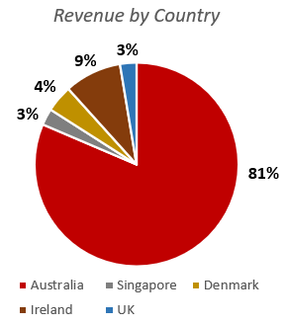
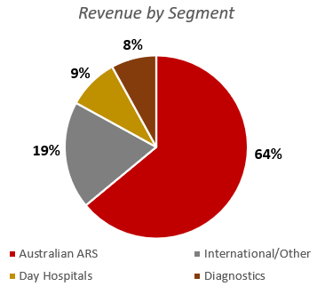
Jason
Virtus Health
Virtus Health is a global leader in Assisted Reproductive Services with a presence across multiple countries
Company Overview Virtus Health (ASX: VRT) started in 2002 through a combination of key state fertility groups and has expanded to be one of the top five global providers of Assisted Reproductive Services in 2021 Virtus operates 44 fertility clinics, 54 laboratories, 10 diagnostic centers and 7- day hospitals in Australia, Ireland, Denmark, UK and Singapore, with a majority holding in Australia After being acquired by Quadrant Private Equity in 2008, Virtus Health went public through an IPO in June 2013 | Key Metrics
Share Price Performance (A$) – Last 3 Years | Revenue Breakdown – 1H22A
Market Capitalisation
$444.2m
Enterprise Value
$520.2m
FY21 EV / Revenue
1.60x
FY21 EV / EBITDA
5.57x
FY21 EV / EBIT
7.51x
FY21 P/E
12.41x
Source: IBISworld Industry Report and Company Fillings. Barchart as of 31 June 2021 and 31 Dec 2021.
For use in the 2023 UBS IB Development Challenge only

Slide 25
Harley / Jason
ARS Industry in Australia
The ARS industry increased by 7.1% CAGR from 2000 to 2021 and is dominated by 3 major operators.
Industry Overview
In 2021, there were ~100 ARS clinics across Australia; with Virtus Health and Monash IVF dominating ~55% of market share combined.
The Australian ARS industry is tightly regulated and consists of separate state-based legislations, as well as a requirement to engage in substantial R&D investment.
Strong advancements in detecting and treating infertility have raised global awareness of ARS.
There are three different ARS treatment available including:
In-vitro fertilization (IVF): Fertilization outside the body in a lab, followed by embryo transfer to the uterus.
Intracytoplasmic sperm injection (ICSI): Direct injection of a sperm into an egg to aid fertilization.
Frozen Embryo Transfer (FET): Transfer of previously frozen embryos to the uterus to increase chances of pregnancy.
Comparison of Major ARS Operators
 | Virtus | Monash IVF | Genea
Market Capitalisation (Dec 21) | 444.2m | 366.3m | n.a.
Service Revenue (FY21) | 324.6m | 183.6m | 93.7m
Market Share | 39.5% | 25.3% | 12.6%
ART Clinics | 44 | 27 | 12
Fertility Specialists | 128 | 105 | 38
Service Revenue CAGR(FY19 to FY21) | 7.7% | 9.9% | 0.5%
EBITDA Margin (FY21) | 25.9% | 26.0% | 13.1%
Cycles | 23,994 | 10,815 | 8,864
Revenue per cycle (AUD) | 13,528 | 16,977 | 10,567
% International Revenue (FY21) | 20.1% | 5.8% | 12.4%
Source: Company Filings.
For use in the 2023 UBS IB Development Challenge only

